Slide 1
MEP Issues
For Static Check Exceptions

Slide 2
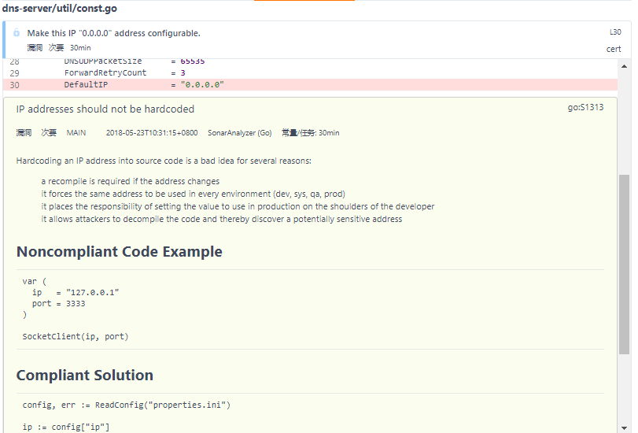
Issue 1: “Make this IP "0.0.0.0" address configurable.”
The DefaultIP is used in the command line parameters, which is already a user configurable value.
Hence this issue is not valid.

Slide 3
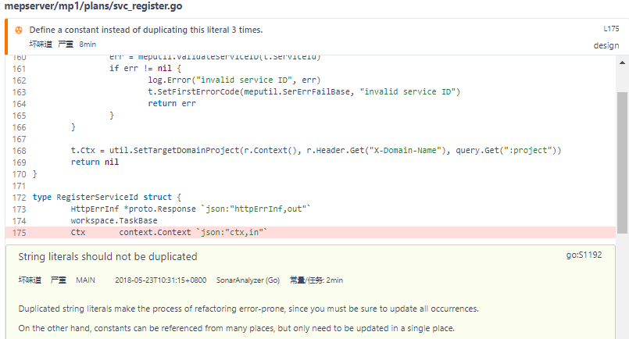
Issue 2: “Define a constant instead of duplicating this literal 3 times.”
The literal is used as part of the data bus, hence we cannot change this to a constant.

Slide 4
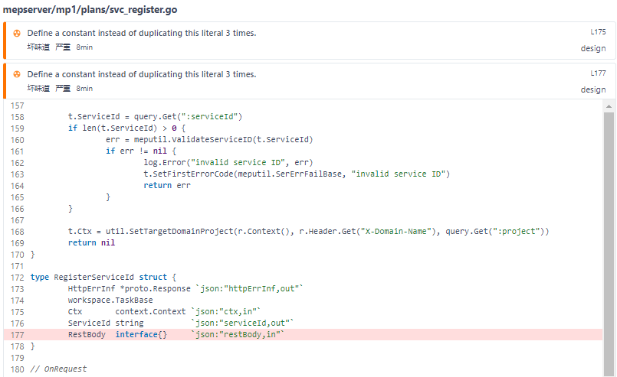
Issue 3: “Define a constant instead of duplicating this literal 3 times.”
The literal is used as part of the data bus, hence we cannot change this to a constant.

